Slide 1

6th Grade Math
Unit 8, Lesson 9 Nets of Rectangular Prisms and Pyramids Volume 2, pg. 120

Slide 2


Benchmark
MA.6.GR.2.4
Given a mathematical or real-world context, find the surface area of right rectangular prisms and right rectangular pyramids using the figure’s net.
volume 2, pg. 120

Slide 3
Integrated Mathematical Thinking and Reasoning Standards
MA.K12.MTR.1.1 Actively participate in effortful learning both individually and collectively.
MA.K12.MTR.2.1 Demonstrate understanding by representing problems in multiple ways.
MA.K12.MTR.4.1 Engage in discussions that reflect on the mathematical thinking of self and others.
MA.K12.MTR.5.1 Use patterns and structure to help understand and connect mathematical concepts.
volume 2, pg. 120

Slide 4

Learning Targets
I can draw the net of a rectangular prism or rectangular pyramid.
I can relate a net to its three-dimensional shape.
I can relate a rectangular prism or rectangular pyramid to its net.
volume 2, pg. 120

Slide 5

Warm-Up
volume 2, pg. 120

Slide 6
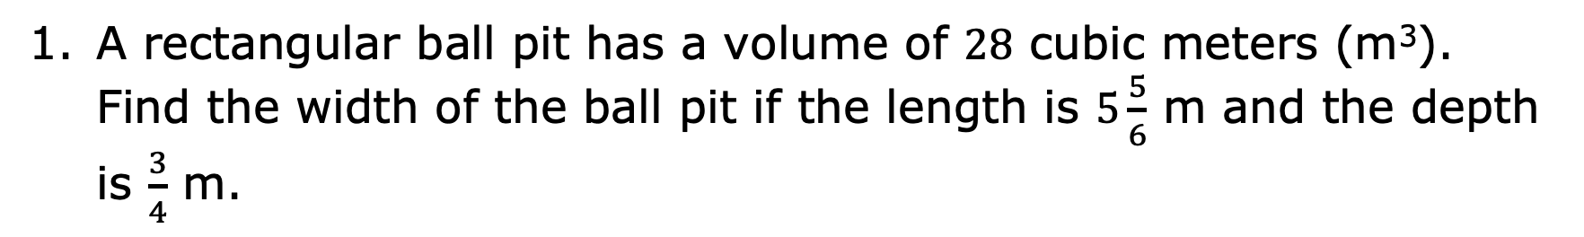
8.9.1 Warm-Up: Bell Work
A rectangular ball pit has a volume of $28$ cubic meters (m³). Find the width of the ball pit if the length is $5\frac{5}{6}$ m and the depth is $\frac{3}{4}$ m.
volume 2, pg. 120

Slide 7

Refresher
volume 2, pg. 121

Slide 8
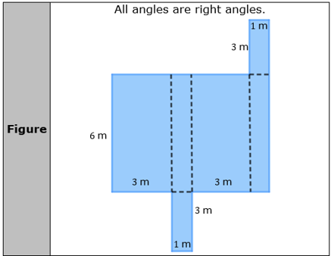
8.9.2 Refresher: Area of Composite Figures
Work with your partner to find the area of each composite figure. All measurements are in meters (m).
volume 2, pg. 121

Slide 9
Area
volume 2, pg. 121

Slide 10
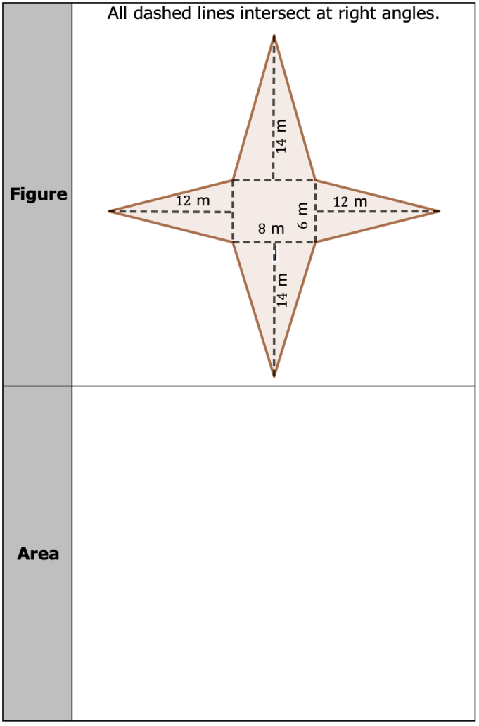
volume 2, pg. 121

Slide 11

Exploration
volume 2, pg. 122

Slide 12


8.9.3 Exploration: Creating Three-Dimensional Figures
Both composite figures in the previous component are nets. A net is formed when the faces of a three-dimensional figure are positioned by arranging the faces to create a two-dimensional composite figure.
A net is a two-dimensional diagram that can be folded or made into a three-dimensional figure.
Your teacher will provide you with copies of some nets. Cut the nets along the solid line. Fold the nets along the dotted line and use the tabs to glue the figure together.
volume 2, pg. 122

Slide 13
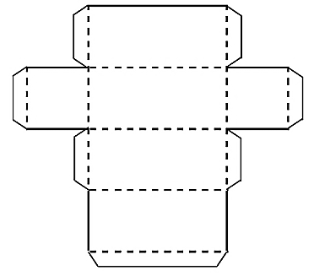
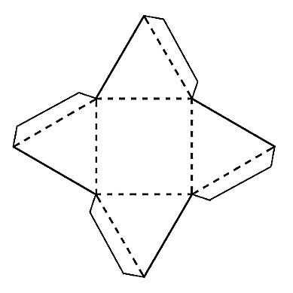
Complete the table to describe the three-dimensional figure formed.
Net | Three-Dimensional Figure Formed
volume 2, pg. 122

Slide 14
Look back at the two composite figures from the refresher. Predict what three-dimensional figure is made from cutting out and folding up the sides of those figures.
With your partner, discuss how the area of a two-dimensional composite figure is related to the area of the faces of the three-dimensional figure. Summarize your discussion.
volume 2, pg. 122

Slide 15

Collaboration
volume 2, pg. 123

Slide 16
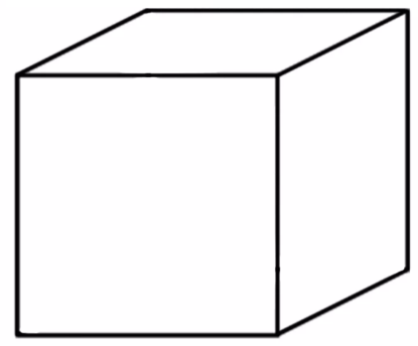

8.9.4 Collaboration: Determining Nets
With your partner, sketch the net or sketch the individual faces of the three-dimensional figure. Label each side of the net with the appropriate measurement in yards (yd).
Three-Dimensional Figure | Net
$5$ yd
$5$ yd
$5$ yd
volume 2, pg. 123

Slide 17
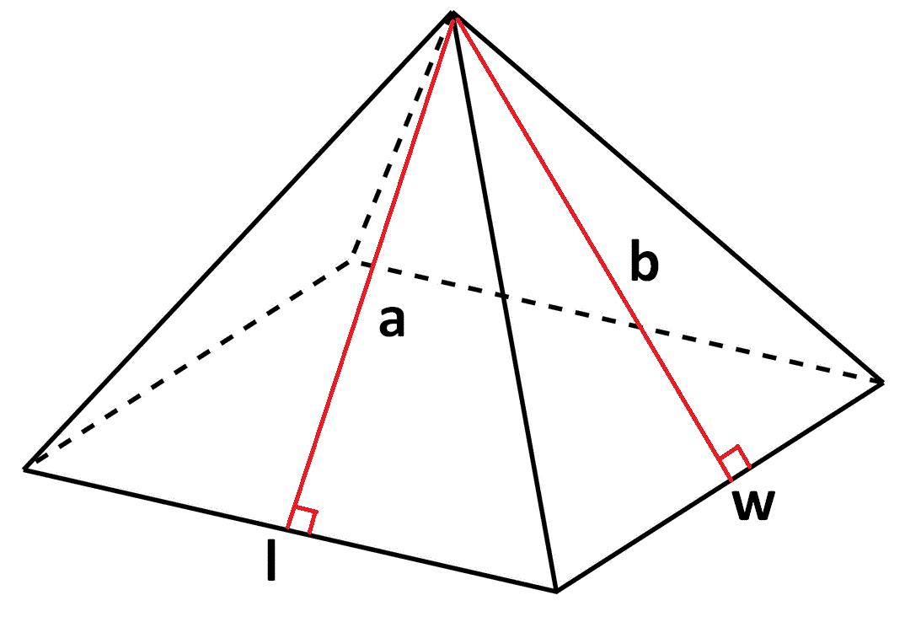
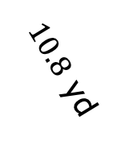
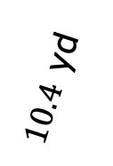
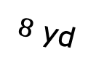
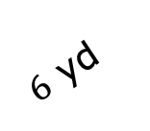
Three-Dimensional Figure | Net
$10.8$ yd
$10.4$ yd
$6$ yd
$8$ yd
volume 2, pg. 123

Slide 18

Wrap-Up
volume 2, pg. 123

Slide 19

8.9.5 Wrap-Up: Reflection
What was the muddiest (most difficult or confusing) point in today’s lesson on nets?
volume 2, pg. 123

